Slide 1

Univ AI1
All in one !!!

Slide 2

1
Project Charter review
2
Gantt Chart
3
Work Breakdown Structure
4
Class Diagram
5
Software Design
Content
6
Interface Design
7
Problem Solving
8
Final delivery of package
9
Lessons Learnt
Content

Slide 3
Project Charter Review
Background | Objective
Finding a university considering: Curriculum World-Ranking Fees structure Internship opportunities Crime rate of the city | One-stop platform Verified User-inputs Agile software development model Essential information about the university Easy-to-use website application

Slide 4
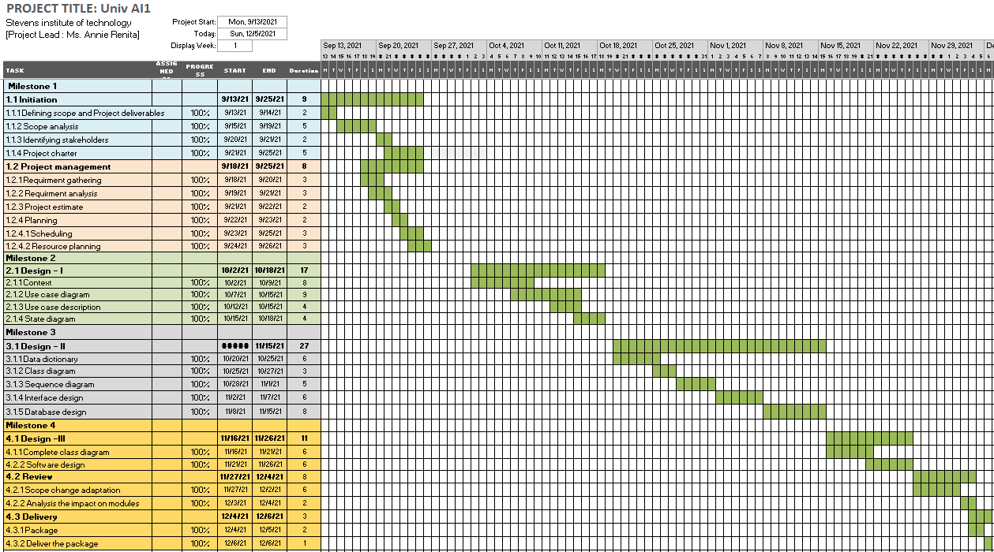

Slide 5
Work Breakdown Structure
Phase 1 : (Milestone 1)
1.1 Initiation
1.1.1 Defining scope and project deliverables
1.1.2 Scope analysis
1.1.3 Identifying stakeholders
1.1.4 Project charter
1.2 Project management
1.2.1 Requirement gathering
1.2.2 Requirement analysis
1.2.3 Project estimate
1.2.4 Planning
1.2.4.1 Scheduling
1.2.4.2 Resource planning
Phase 2 : (Milestone 2)
2.1 Design - I
2.1.1 Context Design
2.1.2 Use case diagram
2.1.3 Choreography diagram
2.1.4 Use case description
Phase 3 : (Milestone 3)
3.1 Design -II
3.1.1 Data dictionary
3.1.2 Class diagram (without methods)
3.1.3 Sequence diagram
3.1.4 Interface diagram
3.1.5 Database diagram
Phase 4 : (Milestone 4)
4.1 Design - III
4.1.1 Complete class diagram (with methods)
4,1.2 Software design
4.2 Review
4.2.1 Adaptation of any scope changes
4.2.2 Analyze the impact on modules
4.2.3 Review the project
4.2 Delivery
4.3.1 Package creation
4.3.2 Deliver the package (report)

Slide 6
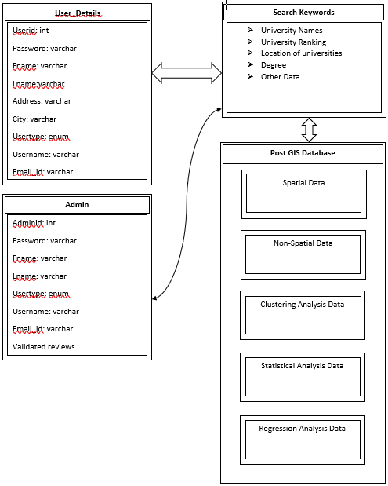
Class Diagram

Slide 7
Software Design
Method: | Find Universities
Clients: | Students, Parents, Teachers, Professors
Associated Use cases: | To find universities of NJ & NYC on geographical map, university list or search bar
Responsibilities description: | To display universities as per applied filters
Arguments Received: | Choice of the universities by clients
Type of Value Returned: | Universities of the specific location
Method: | Check university rank
Clients: | Students, Parents, Teachers, Professors
Associated Use cases: | To find the rank of the university
Responsibilities description: | To display the World rank, Country rank of the university
Arguments Received: | Name of the university/Select university on map
Type of Value Returned: | Rank of the university based on selected category

Slide 8
Method: | To find the programs offered by the university
Clients: | Students, Parents, Teachers, Professors
Associated Use cases: | To find all the undergraduate and graduate programs offered by the university
Responsibilities description: | 1) To display the list of programs offered in the university 2) To shortlist the university based on selected program
Arguments Received: | Name of the university and interested program of the client
Type of Value Returned: | University-wise list of undergraduate and graduate program
Method: | Reviews of the university
Clients: | Students, Parents, Teachers, Professors
Associated Use cases: | To check the reviews of the university
Responsibilities description: | To display the reviews of the university that are given by the students studying in that university
Arguments Received: | Name of the university/Select university on map
Type of Value Returned: | The validated reviews of the students

Slide 9
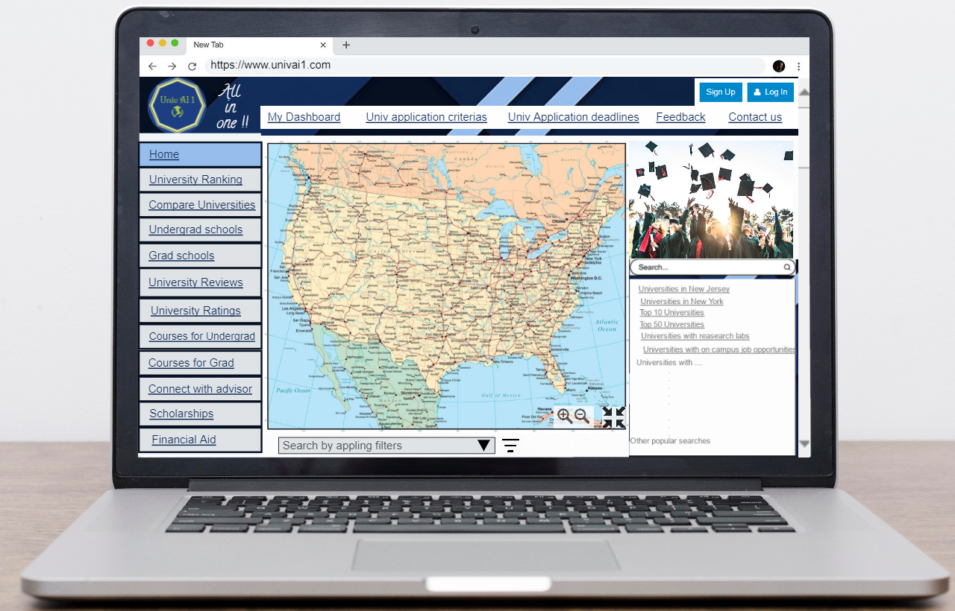
Interface Design - Home page

Slide 10
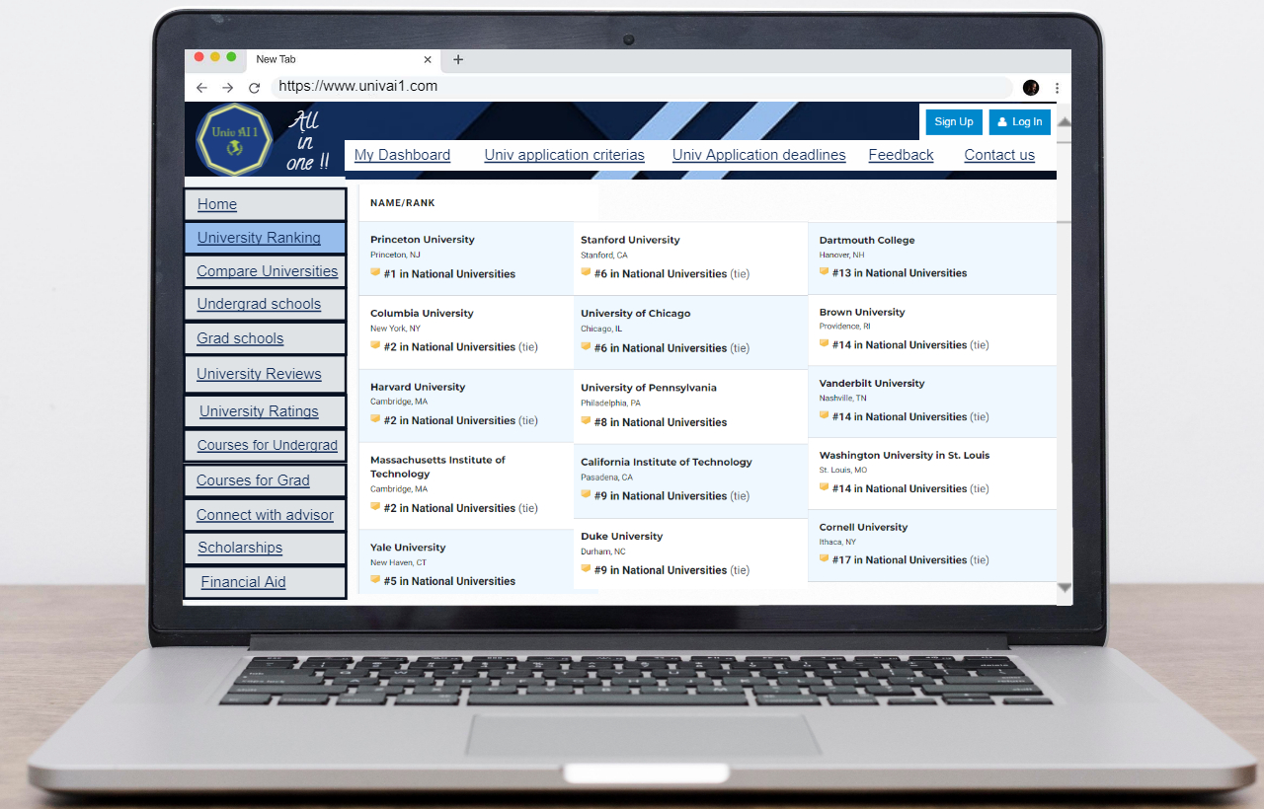
University ranking page

Slide 11
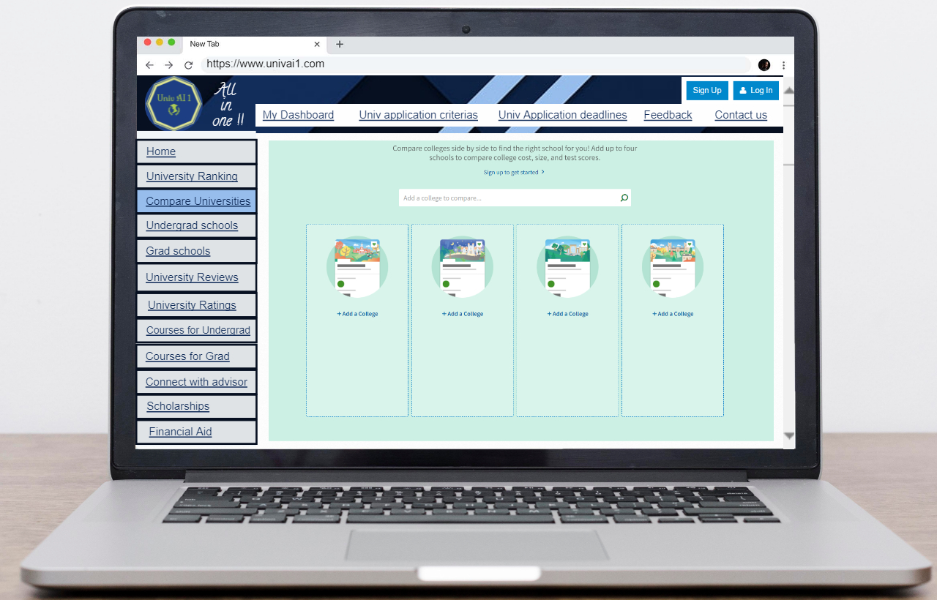
Compare Universities page

Slide 12
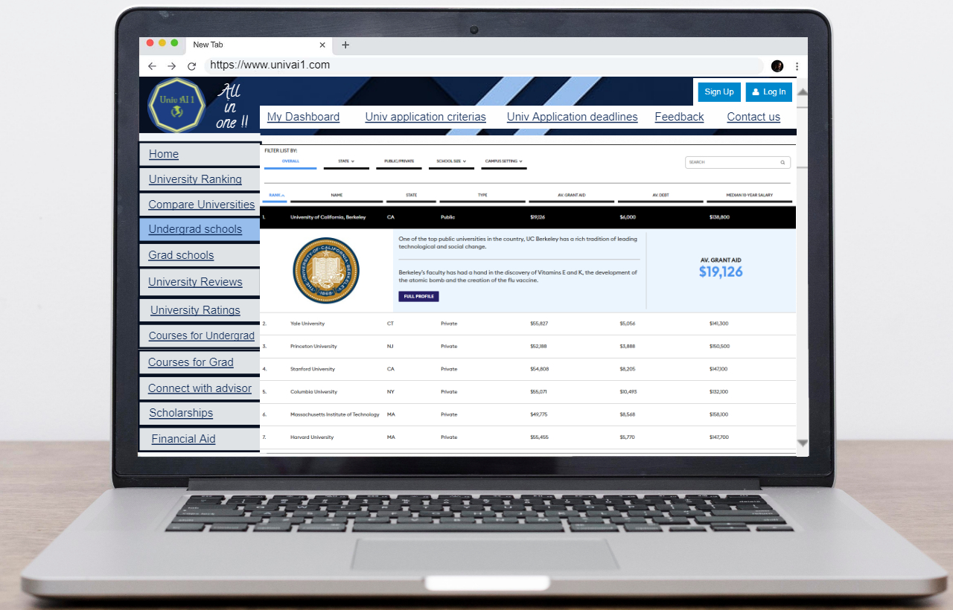
Undergrad Schools

Slide 13
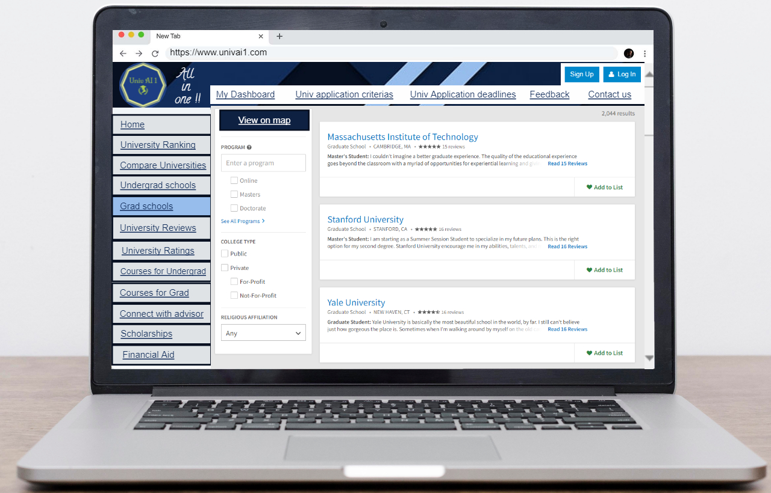
Grad Schools

Slide 14
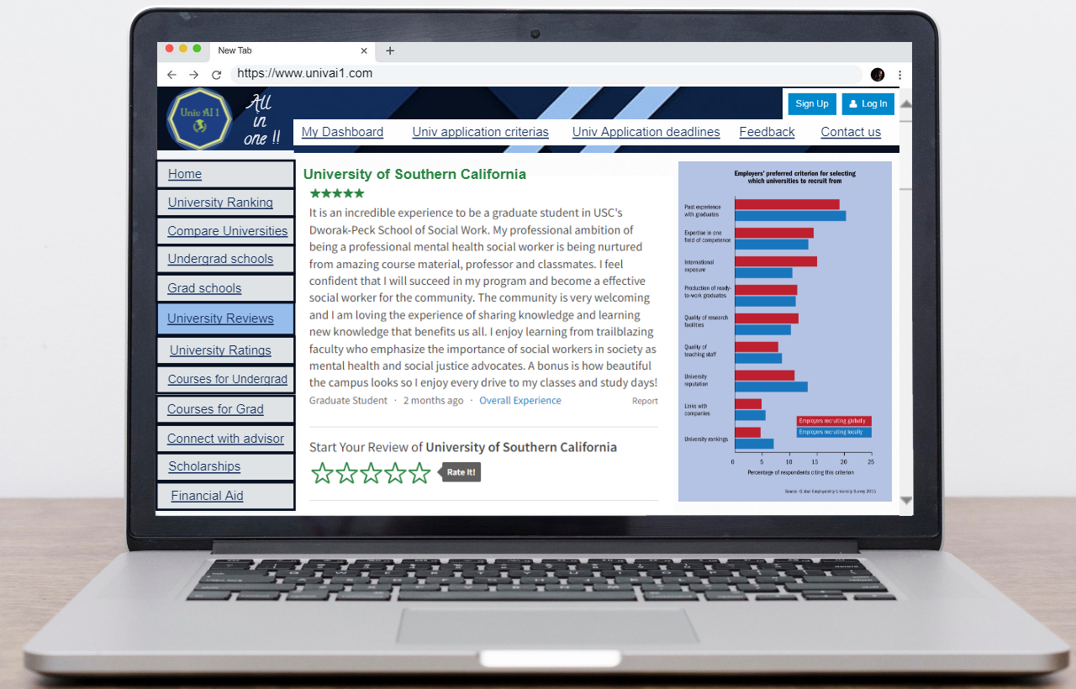
University reviews

Slide 15
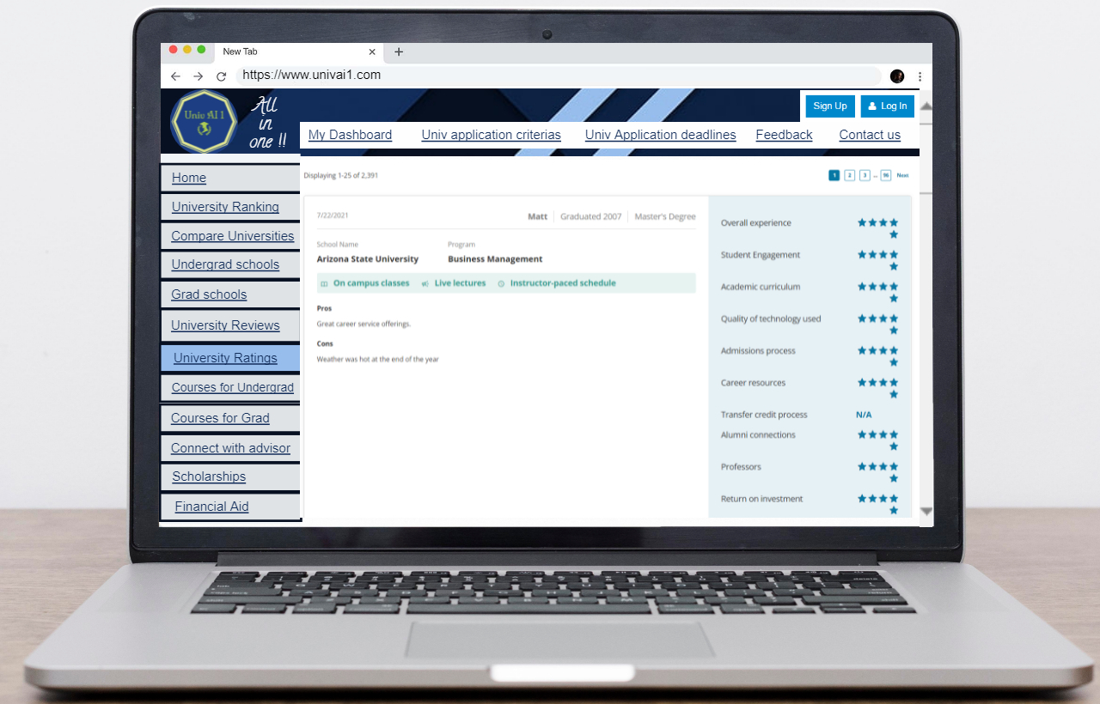
University Ratings

Slide 16
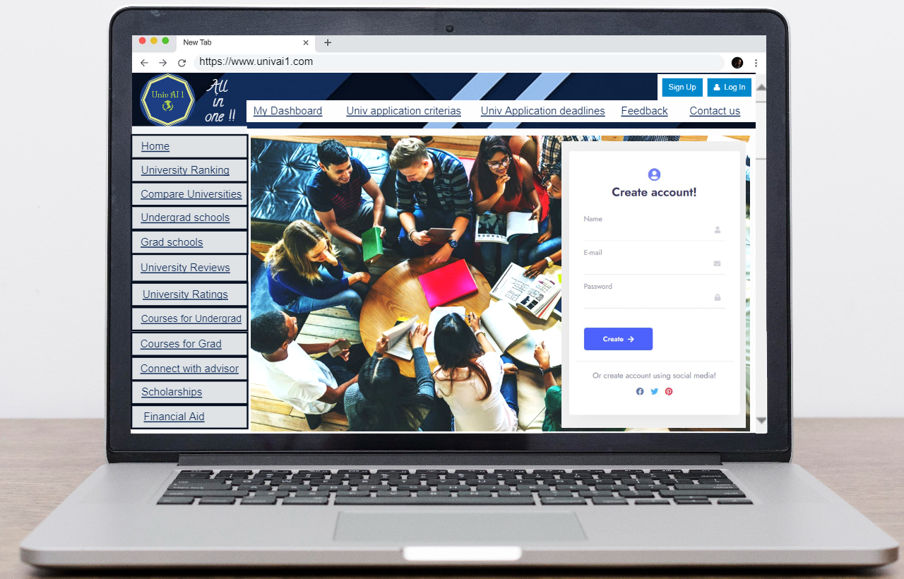
Sign up page

Slide 17
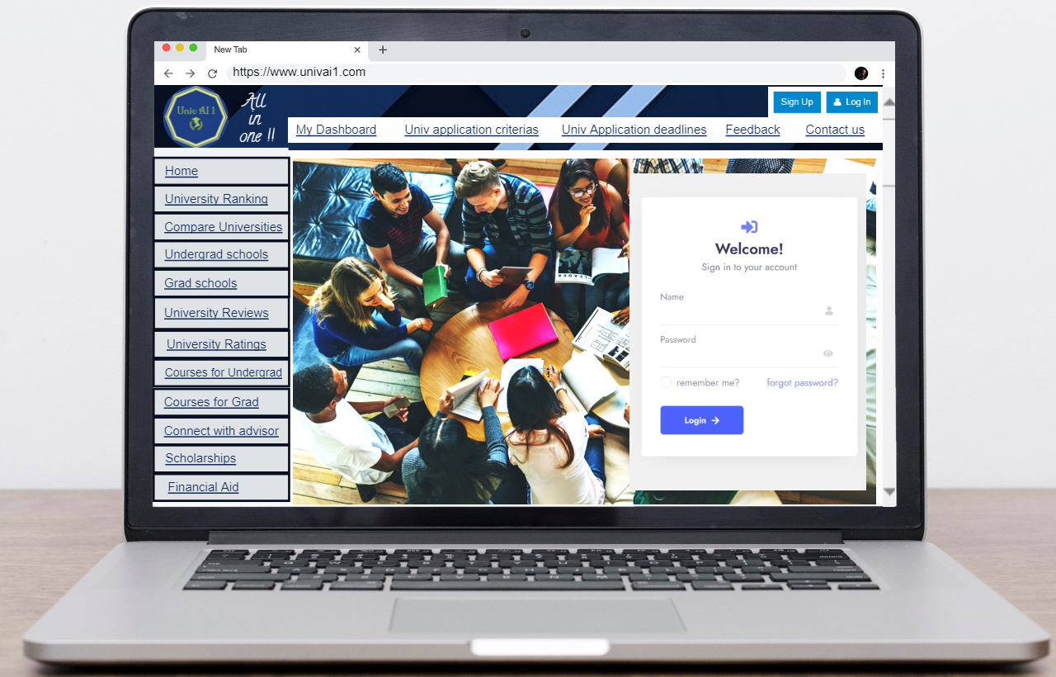
Login page

Slide 18
Problem Solving
Finding a university to get the best opportunities for you to enhance your skills and get placed at your dream university with all the facilities, coursework and other demographics of your choice.
Many students and parents find it difficult to find information about different universities and their pros and cons.
It is a hassle to juggle around between different university sites to find information that is relevant to your requirements to find your perfect university.
Need for a source verified review system about the universities, will be helpful for students and parents all around the world.
Data integrity is an important factor that is prioritized in the design of the application.

Slide 19



Ranking
Resources and Reviews
Time consuming
is important for students to choose universities beneficial for their future opportunities.
are necessary in-order to decide on best university fit for you.
as we have to collect information from different sites.

Slide 20
Domain Knowledge Learnt:
1)Academic system in the US of various universities depending whether they are public or private universities. Bachelor degrees, Graduate degrees, Doctoral program/ degree, professional degree (specialized degrees), pros and cons of being in public/ private universities.
2)Geographic Information System:
A Geographic Information System (GIS) is a computer system that analyzes and displays geographically referenced information. It uses data that is attached to a unique location. ... These are just a few examples of the many uses of GIS in earth sciences, biology, resource management, and many other fields.
3)Unified Modeling Language:
The Unified Modeling Language is a general-purpose, developmental, modeling language in the field of software engineering that is intended to provide a standard way to visualize the design of a system.

Slide 21
Project Management Software
1)Jira - (4 Sprints for covering 4 milestones)
I had created tasks according to the work break down structure for each sprint.
2)Google Meet:
To conduct meetings and discuss about the project and communicate.
3) Group Me:
To co-ordinate and communicate with teammates about the project and presentations, etc.

Slide 22
Lessons learnt :
Usability comes first. Always!! Innovation is great but usability is much more important.
Scheduling meeting and communicating with teammates having
different schedules.
Sticking to the timeline.
Coding was difficult within the timeline so adapted the changes in scope (from coding to designing the website).
Zoom Meetings for communication and

Slide 23

Thanks!

